Slide 1

CECS 378 Section 04 Lecture will start shortly…

Slide 2
Computing Security: Principles and Practice Chapter 21 – Public-Key Cryptography & Message Authentication February 10th & 15th, 2021 CECS 378 - Spring 2021

Slide 3
Chapter 21 Overview
Secure Hash Functions
HMAC
Authenticated Encryption
The RSA Public-Key Encryption Algorithm
Diffie-Hellman and Other Asymmetric Algorithms
Key Terms, Review Questions, and Problems
Notes:
This chapter provides technical detail on the topics introduced in Sections 2.2
through 2.4 .

Slide 4
Simple Hash Functions
A one-way or secure hash function used in message authentication, digital signatures
All hash functions process input a block at a time in an interative fashion
One of simplest hash functions is the bit-by-bit exclusive-OR (XOR) of each block
Effective data integrity check on random data
Less effective on more predictable data
Virtually useless for data security
Notes:
The one-way hash function, or secure hash function, is important not only in
message authentication but also in digital signatures. The requirements for and
security of secure hash functions are discussed in Section 2.2 . Here, we look at
several hash functions, concentrating on perhaps the most widely used family of
hash functions: SHA.
All hash functions operate using the following general principles. The input
(message, file, etc.) is viewed as a sequence of n -bit blocks. The input is processed
one block at a time in an iterative fashion to produce an n -bit hash function.
One of the simplest hash functions is the bit-by-bit exclusive-OR (XOR) of
every block. This can be expressed as follows:
C_{i} = b_{i1} ⊕ b_{i2} ⊕ . . . ⊕ b_{im}

Slide 5
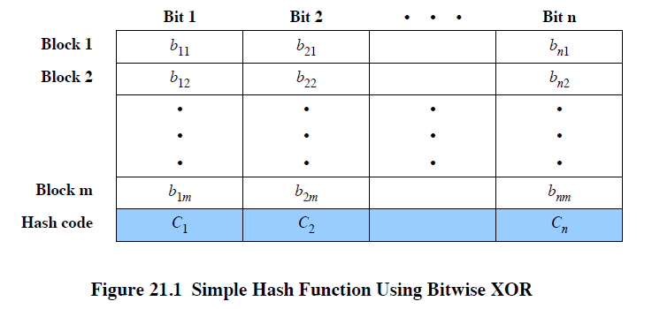
Simple Hash Function
Notes:
Figure 21.1 illustrates this operation; it produces a simple parity for each bit
position and is known as a longitudinal redundancy check. It is reasonably effective
for random data as a data integrity check. Each n -bit hash value is equally likely.
Thus, the probability that a data error will result in an unchanged hash value is 2^{-n}.
With more predictably formatted data, the function is less effective. For example, in
most normal text files, the high-order bit of each octet is always zero. So if a 128-bit
hash value is used, instead of an effectiveness of 2⁻¹²⁸, the hash function on this type
of data has an effectiveness of 2⁻¹¹².

Slide 6
Secure Hash Algorithm (SHA)
SHA was originally developed by NIST/NSA in 1993
Published as FIPS 180 in 1993
Was revised in 1995 as SHA-1
Produces 160-bit hash values
NIST issued revised FIPS 180-2 in 2002
Adds 3 additional versions of SHA
SHA-256, SHA-384, SHA-512
With 256/384/512-bit hash values
Same basic structure as SHA-1 but greater security
The most recent version is FIPS 180-4 which added two variants of SHA-512 with 224-bit and 256-bit hash sizes
Notes:
In recent years, the most widely used hash function has been the Secure Hash Algorithm
(SHA). Indeed, because virtually every other widely used hash function had
been found to have substantial cryptanalytic weaknesses, SHA was more or less the
last remaining standardized hash algorithm by 2005. SHA was developed by the
National Institute of Standards and Technology (NIST) and published as FIPS 180 in
1993. When weaknesses were discovered in SHA (now known as SHA-0), a revised
version was issued as FIPS 180-1 in 1995 and is referred to as SHA-1 . The actual
standards document is entitled “Secure Hash Standard. SHA-1 is also specified in
RFC 3174 (US Secure Hash Algorithm 1 (SHA1) , 2001), which essentially duplicates
the material in FIPS 180-1 but adds a C code implementation.
SHA-1 produces a hash value of 160 bits. In 2002, NIST produced a revised version
of the standard, FIPS 180-2, that defined three new versions of SHA, with hash
value lengths of 256, 384, and 512 bits, known as SHA-256, SHA-384, and SHA-512,
respectively (see Table 21.1). Collectively, these hash algorithms are known as SHA-2 .
These new versions have the same underlying structure and use the same types of
modular arithmetic and logical binary operations as SHA-1. A revised document was
issued as FIPS 180-3 in 2008, which added a 224-bit version of SHA-256, whose hash
value is obtained by truncating the 256-bit hash value of SHA-256. SHA-1 and SHA-2
are also specified in RFC 6234 (US Secure Hash Algorithms (SHA and SHA-based
HMAC and HKDF ), 2011), which essentially duplicates the material in FIPS 180-3 but
adds a C code implementation. The most recent version is FIPS 180-4 [Secure Hash
Standard (SHS) , August 2015] which added two variants of SHA-512 with 224-bit and
256-bit hash sizes, as SHA-512 is more efficient than SHA-256 on many 64-bit systems.
In 2005, NIST announced the intention to phase out approval of SHA-1 and move
to a reliance on SHA-2 by 2010. Shortly thereafter, a research team described an attack
in which two separate messages could be found that deliver the same SHA-1 hash using
2⁶⁹ operations, far fewer than the 2⁸⁰ operations previously thought needed to find a collision
with an SHA-1 hash [WANG05]. This result has hastened the transition to SHA-2.
In this section, we provide a description of SHA-512. The other versions are
quite similar. The algorithm takes as input a message with a maximum length of
less than 2 ¹²⁸ bits and produces as output a 512-bit message digest. The input is
processed in 1024-bit blocks.

Slide 7
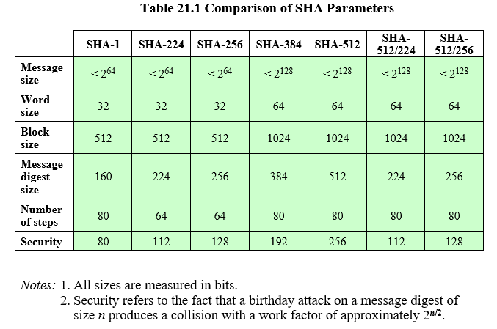
Comparison of SHA Parameters
Notes:
Table 21.1
Comparison of SHA parameters.

Slide 8
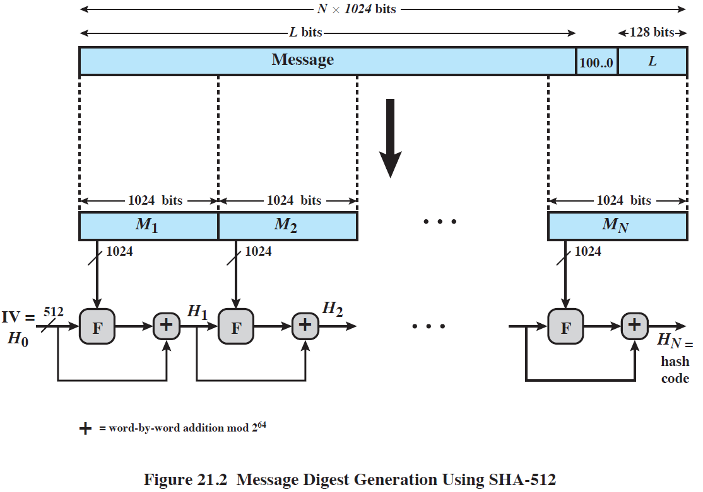
SHA-512 Structure
Notes:
Figure 21.2 depicts the overall processing of a message
to produce a digest. The processing consists of the following steps:
• Step 1: Append padding bits: so that message length is congruent to 896 modulo 1024 [length ≡ 896 (mod 1024)]. The padding consists of a single 1-bit followed by the necessary number of 0-bits.
• Step 2: Append length: as a block of 128 bits being an unsigned 128-bit integer length of the original message (before padding).
• Step 3: Initialize hash buffer: A 512-bit buffer is used to hold intermediate and
final results of the hash function. The buffer can be represented as eight 64-bit
registers (a, b, c, d, e, f, g, h).
• Step 4: Process the message in 1024-bit (128-word) blocks, The heart of the
algorithm is a module that consists of 80 rounds; this module is labeled F in
Figure 21.2.
• Step 5: Output. After all N 1024-bit blocks have been processed, the output
from the N th stage is the 512-bit message digest.

Slide 9
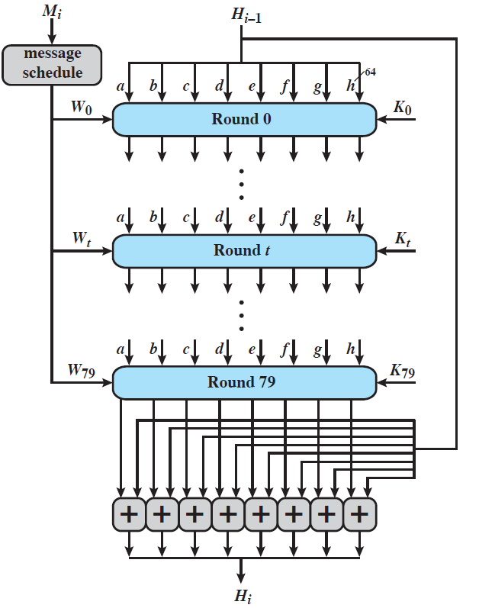
SHA-512 Round
Notes:
The logic is illustrated in Figure 21.3.
Each round takes as input the 512-bit buffer value abcdefgh, and updates the contents of the buffer. At input to the first round, the buffer has the value of the intermediate hash value, H_{i–1}. Each round t makes use of a 64-bit value W_{t}, derived from the current 1024-bit block being processed (M_{i}). Each round also makes use of an additive constant K_{t}, where 0 ≤ t ≤ 79 indicates one of the 80 rounds. These words represent the first sixty-four bits of the fractional parts of the cube roots of the first eighty prime numbers. The constants provide a “randomized” set of 64-bit patterns, which should eliminate any regularities in the input data. The operations performed during a round consist of circular shifts, and primitive Boolean functions based on AND, OR, NOT, and XOR.
The output of the eightieth round is added to the input to the first round (H_{i–1}) to produce H_{i}. The addition is done independently for each of the eight words in the buffer with each of the corresponding words in H_{i–1}, using addition modulo 2⁶⁴.
The SHA-512 algorithm has the property that every bit of the hash code is a
function of every bit of the input. The complex repetition of the basic function F
produces results that are well mixed; that is, it is unlikely that two messages chosen at
random, even if they exhibit similar regularities, will have the same hash code. Unless
there is some hidden weakness in SHA-512, which has not so far been published, the
difficulty of coming up with two messages having the same message digest is on the
order of 2²⁵⁶ operations, while the difficulty of finding a message with a given digest
is on the order of 2⁵¹² operations.

Slide 10
SHA-3
SHA-2 shares same structure and mathematical operations as its predecessors and causes concern
Due to time required to replace SHA-2 should it become vulnerable, NIST announced in 2007 a competition to produce SHA-3
Requirements:
Must support hash value lengths of 224, 256, 384, and 512 bits
Algorithm must process small blocks at a time instead of requiring the entire message to be buffered in memory before processing it
Notes:
SHA-2, particularly the 512-bit version, would appear to provide unassailable
security. However, SHA-2 shares the same structure and mathematical operations
as its predecessors, and this is a cause for concern. Because it will take years to find
a suitable replacement for SHA-2, should it become vulnerable, NIST announced in 2007 a
competition to produce the next generation NIST hash function, to be called SHA-3.
The basic requirements that needed to be satisfied by any candidate for SHA-3 are
the following:
1. It must be possible to replace SHA-2 with SHA-3 in any application by a simple
drop-in substitution. Therefore, SHA-3 must support hash value lengths of
224, 256, 384, and 512 bits.
2. SHA-3 must preserve the online nature of SHA-2. That is, the algorithm must
process comparatively small blocks (512 or 1024 bits) at a time instead of
requiring that the entire message be buffered in memory before processing it.
After an extensive consultation and vetting process, NIST selected a winning
submission and formally published SHA-3 as FIPS 202 (SHA-3 Standard: Permutation-
Based Hash and Extendable-Output Functions, August 2015).
The structure and functions used for SHA-3 are substantially different from
those shared by SHA-2 and SHA-1. Thus, if weaknesses are discovered in either
SHA-2 or SHA-3, users have the option to switch to the other standard. SHA-2
has held up well and NIST considers it secure for general use. So for now, SHA-3
is a complement to SHA-2 rather than a replacement. The relatively compact
nature of SHA-3 may make it useful for so-called “embedded” or smart devices
that connect to electronic networks but are not themselves full-fledged computers.
Examples include sensors in a building-wide security system and home appliances
that can be controlled remotely. A detailed presentation of SHA-3 is provided in
Appendix K.

Slide 11
Other Secure Hash Functions
Most based on iterated hash function design
If compression function is collision resistant
So is resultant iterated hash function
MD5 (RFC 1321)
Was a widely used hash developed by Ron Rivest
Produces 128-bit hash, now too small
Also have cryptanalytic concerns
Whirlpool (NESSIE endorsed hash)
Developed by Vincent Rijmen & Paulo Barreto
Compression function is AES derived W block cipher
Produces 512-bit hash

Slide 12
HMAC
Interest in developing a MAC derived from a cryptographic hash code
Cryptographic hash functions generally execute faster
Library code is widely available
SHA-1 not designed for use as a MAC because it does not rely on a secret key
Issued as RFC 2104
Has been chosen as the mandatory-to-implement MAC for IP security
Used in other Internet protocols such as Transport Layer Security (TLS) and Secure Electronic Transaction (SET)
Notes:
In this section, we look at the hash-code approach to message authentication.
Appendix E looks at message authentication based on block ciphers. In recent years,
there has been increased interest in developing a MAC derived from a cryptographic
hash code, such as SHA-1. The motivations for this interest are as follows:
• Cryptographic hash functions generally execute faster in software than
conventional encryption algorithms such as DES.
• Library code for cryptographic hash functions is widely available.
A hash function such as SHA-1 was not designed for use as a MAC and cannot
be used directly for that purpose because it does not rely on a secret key. There have
been a number of proposals for the incorporation of a secret key into an existing hash
algorithm. The approach that has received the most support is HMAC [BELL96].
HMAC has been issued as RFC 2104 (HMAC: Keyed-Hashing for Message Authentication ,
1997), has been chosen as the mandatory-to-implement
MAC for IP Security, and is used in other Internet protocols,
such as Transport Layer Security (TLS, soon to replace Secure Sockets Layer) and Secure
Electronic Transaction (SET).

Slide 13
HMAC Design Objectives
To use, without modifications, available hash functions
To allow for easy replaceability of the embedded hash function in case faster or more secure hash functions are found or required
To preserve the original performance of the hash function without incurring a significant degradation
To use and handle keys in a simple way
To have a well-understood cryptographic analysis of the strength of the authentication mechanism based on reasonable assumptions on the embedded hash function
Notes:
RFC 2104 lists the following design objectives for HMAC:
• To use, without modifications, available hash functions—in particular, hash
functions that perform well in software, and for which code is freely and
widely available
• To allow for easy replaceability of the embedded hash function in case faster
or more secure hash functions are found or required
• To preserve the original performance of the hash function without incurring a
significant degradation
• To use and handle keys in a simple way
• To have a well-understood cryptographic analysis of the strength of the
authentication mechanism based on reasonable assumptions on the embedded
hash function
The first two objectives are important to the acceptability of HMAC. HMAC
treats the hash function as a “black box.” This has two benefits. First, an existing
implementation of a hash function can be used as a module in implementing
HMAC. In this way, the bulk of the HMAC code is prepackaged and ready to use
without modification. Second, if it is ever desired to replace a given hash function
in an HMAC implementation, all that is required is to remove the existing hash
function module and drop in the new module. This could be done if a faster
hash function were desired. More important, if the security of the embedded hash
function were compromised, the security of HMAC could be retained simply by
replacing the embedded hash function with a more secure one.
The last design objective in the preceding list is, in fact, the main advantage
of HMAC over other proposed hash-based schemes. HMAC can be proven secure
provided that the embedded hash function has some reasonable cryptographic
strengths. We return to this point later in this section, but first we examine the
structure of HMAC.

Slide 14
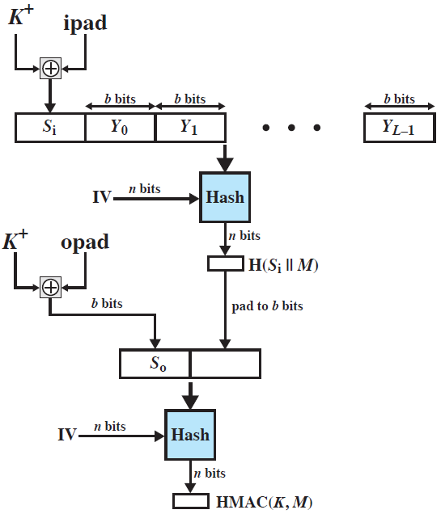

HMAC Structure
Notes:
Figure 21.4 illustrates the overall operation of HMAC.
In words:
1. Append zeros to the left end of K to create a b-bit string K⁺ (e.g., if K is of length 160 bits and b = 512, then K will be appended with 44 zero bytes 0x00).
2. XOR (bitwise exclusive-OR) K⁺ with ipad to produce the b-bit block S_{i}.
3. Append M to S_{i}.
4. Apply H to the stream generated in step 3.
5. XOR K⁺ with opad to produce the b-bit block S_{o}.
6. Append the hash result from step 4 to S_{o}.
7. Apply H to the stream generated in step 6 and output the result.
Note that the XOR with ipad results in flipping one-half of the bits of K .
Similarly, the XOR with opad results in flipping one-half of the bits of K , but a
different set of bits. In effect, by passing S _{i} and S _{o} through the hash algorithm, we
have pseudorandomly generated two keys from K .
HMAC should execute in approximately the same time as the embedded hash
function for long messages. HMAC adds three executions of the basic hash function
(for S _{i ,} S _{o} , and the block produced from the inner hash).

Slide 15
Security of HMAC
Security depends on the cryptographic strength of the underlying hash function
The appeal of HMAC is that its designers have been able to prove an exact relationship between the strength of the embedded hash function and the strength of HMAC
For a given level of effort on messages generated by a legitimate user and seen by the attacker, the probability of successful attack on HMAC is equivalent to one of the following attacks on the embedded hash function:
The attacker is able to compute an output of the compression function even with an IV that is random, secret, and unknown to the attacker
The attacker finds collisions in the hash function even when the IV is random and secret
Notes:
The security of any MAC function based on an embedded hash function depends
in some way on the cryptographic strength of the underlying hash function. The
appeal of HMAC is that its designers have been able to prove an exact relationship
between the strength of the embedded hash function and the strength
of HMAC.
The security of a MAC function is generally expressed in terms of the probability
of successful forgery with a given amount of time spent by the forger and a
given number of message-MAC pairs created with the same key. In essence, it is
proved in [BELL96] that for a given level of effort (time, message-MAC pairs) on
messages generated by a legitimate user and seen by the attacker, the probability
of successful attack on HMAC is equivalent to one of the following attacks on the
embedded hash function:
1. The attacker is able to compute an output of the compression function even
with an IV that is random, secret, and unknown to the attacker.
2. The attacker finds collisions in the hash function even when the IV is random
and secret.
In the first attack, we can view the compression function as equivalent to the
hash function applied to a message consisting of a single b -bit block. For this attack,
the IV of the hash function is replaced by a secret, random value of n bits. An attack
on this hash function requires either a brute-force attack on the key, which is a level
of effort on the order of 2^{n}, or a birthday attack, which is a special case of the second
attack, discussed next.
In the second attack, the attacker is looking for two messages M and M’ that
produce the same hash: H(M’ = H(M’) . This is the birthday attack mentioned
previously. We have stated that this requires a level of effort of 2^{n/2} for a hash length of n . On this
basis, the security of the earlier MD5 hash function was called into question,
because a level of effort of 2⁶⁴ looks feasible with today’s technology. Does this mean that a
128-bit hash function such as MD5 is unsuitable for HMAC? The answer is no, because
of the following argument. To attack MD5, the attacker can choose any set of messages
and work on these offline on a dedicated computing facility to find a collision. Because
the attacker knows the hash algorithm and the default IV, the attacker can generate
the hash code for each of the messages that the attacker generates. However, when
attacking HMAC, the attacker cannot generate message/code pairs offline because
the attacker does not know K. Therefore, the attacker must observe a sequence of
messages generated by HMAC under the same key and perform the attack on these
known messages. For a hash code length of 128 bits, this requires 2⁶⁴ observed blocks
(2⁷² bits) generated using the same key. On a 1-Gbps link, one would need to observe a
continuous stream of messages with no change in key for about 150,000 years in order
to succeed. Thus, if speed is a concern, it is acceptable to use MD5 rather than SHA
as the embedded hash function for HMAC, although use of MD5 is now uncommon.

Slide 16
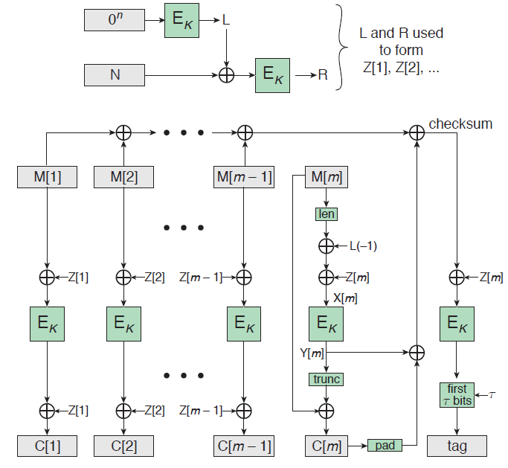
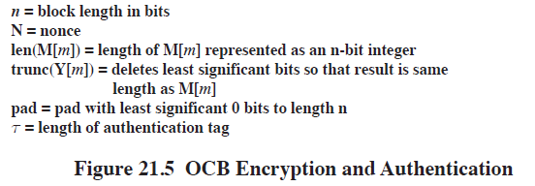
OCB Encryption & Authentication
Notes:
Authenticated encryption (AE) is a term used to describe encryption systems that
simultaneously protect confidentiality and authenticity (integrity) of communications;
that is, AE provides both message encryption and message authentication.
Many applications and protocols require both forms of security, but until recently
the two services have been designed separately. AE is implemented using a block
cipher mode structure. One example that is used in a number of applications is
CCM, described in Appendix E. In this section, we examine Offset Codebook (OCB)
[ROGA03]. OCB is an NIST proposed block cipher mode of operation [ROGA01],
and is a proposed Internet Standard defined in RFC 7253 (The OCB Authenticated-
Encryption Algorithm, 2014). OCB is also approved as an authenticated encryption
technique in the IEEE 802.11 wireless LAN standard. And, as mentioned in
Chapter 13, OCB is included in MiniSec, the open-source IoT security module.
A key objective for OCB is efficiency. This is achieved by minimizing the number
of encryptions required per message and by allowing for parallel operation on
the blocks of a message.
Figure 21.5 shows the overall structure for OCB encryption and authentication.
Typically, AES is used as the encryption algorithm. The message M to be encrypted
and authenticated is divided into n -bit blocks, with the exception of the last block,
which may be less than n bits. Typically, n = 128. Only a single pass through the message
is required to generate both the ciphertext and the authentication code. The total
number of blocks is m = [ len(M)/n].
Note the encryption structure for OCB is similar to that of electronic codebook
(ECB) mode. Each block is encrypted independently of the other blocks, so that it is
possible to perform all m encryptions simultaneously. As was mentioned in Chapter
20, with ECB, if the same b-bit block of plaintext appears more than once in the message,
it always produces the same ciphertext. Because of this, for lengthy messages, the ECB
mode may not be secure.
The upper part of Figure 21.5 indicates how the Z[i ]s are generated. An arbitrary
n -bit value N called the nonce is chosen; the only requirement is that if multiple messages
are encrypted with the same key, a different nonce must be used each time such
that each nonce is only used once. Each different value of N will produce a different
set of Z[i ]. Thus, if two different messages have identical blocks in the same position in
the message, they will produce different ciphertexts because the Z[i ] will be different.

Slide 17
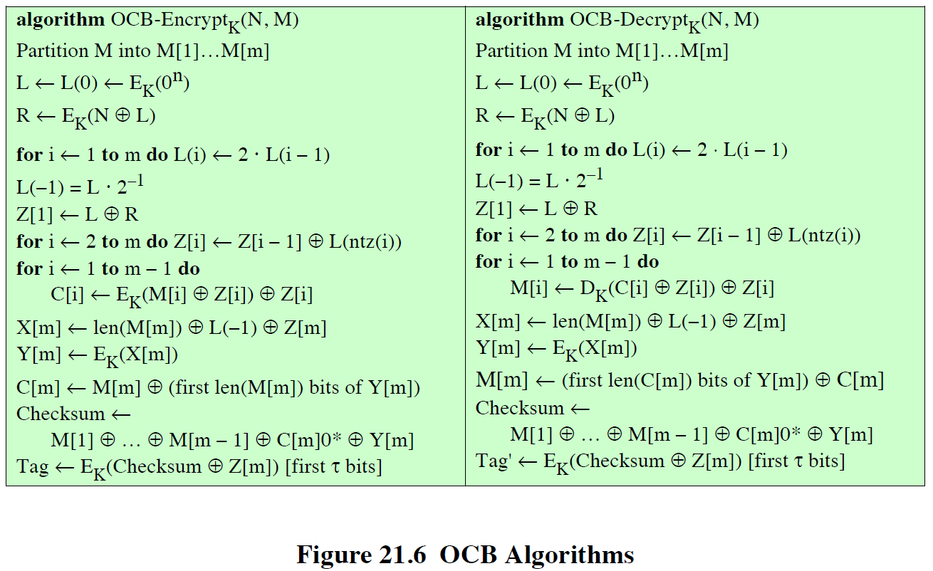
OCB Algorithms
Notes:
Figure 21.6 summarizes the OCB algorithms for encryption and decryption.

Slide 18
RSA Public-Key Encryption
By Rivest, Shamir, & Adleman of MIT in 1977
Best known and widely used public-key algorithm
Relies on difficulty factoring the product of two prime numbers (modulus)
Encrypt: C = Me mod n
Decrypt: M = C^{d} mod n = (Me)^{d} mod n = M
Both sender and receiver know values of n and e
Only receiver knows value of d
Public-key encryption algorithm with:
Public Key PU = {e,n} and Private Key PR = {d,n}
Notes:
Perhaps the most widely used public-key algorithms are RSA and Diffie-Hellman.
One of the first public-key schemes was developed in 1977 by Ron Rivest, Adi Shamir, and Len Adleman at MIT and first published in 1978 [RIVE78]. The RSA scheme has since that time reigned supreme as the most widely accepted and implemented approach to public-key encryption. RSA is a block cipher in which the plaintext and ciphertext are integers between 0 and n – 1 for some n.
Encryption and decryption are of the following form, for some plaintext block M and ciphertext block C:
C = Me mod n
M = C^{d} mod n = (Me)^{d} mod n = M^{ed} mod n
Both sender and receiver must know the values of n and e, and only the receiver knows the value of d. This is a public-key encryption algorithm with a public key of PU = {e, n} and a private key of PR = {d, n}. See text for details of how these values are derived, and their requirements.

Slide 19
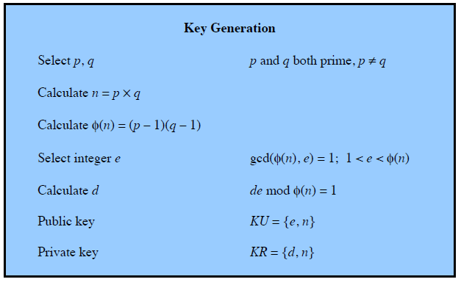
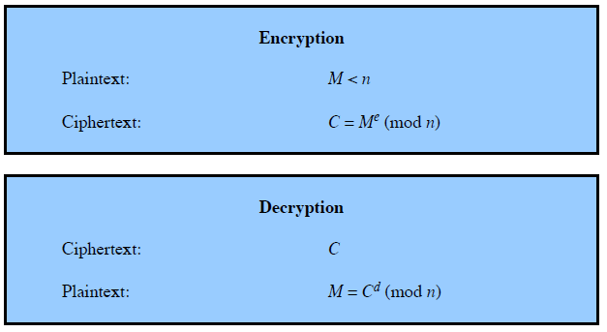
RSA Algorithm
Notes:
Figure 21.7 summarizes the RSA algorithm.

Slide 20
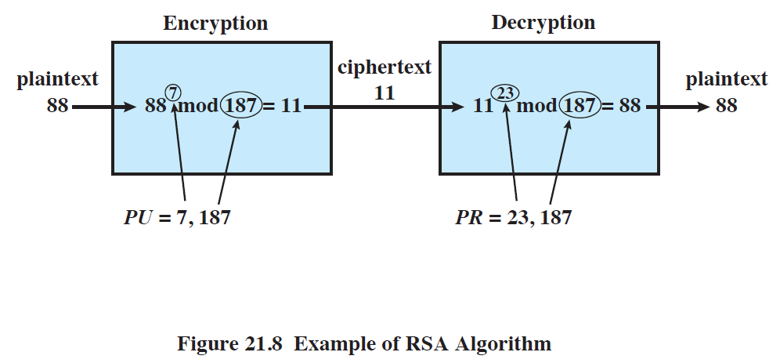
RSA Example
Notes:
An example, from [SING99], is shown in Figure 21.8.
Page 649 in the textbook!!

Slide 21
Security of RSA
Brute force
Involves trying all possible private keys
Mathematical attacks
There are several approaches, all equivalent in effort to factoring the product of two primes
Timing attacks
These depend on the running time of the decryption algorithm
Chosen ciphertext attacks
This type of attack exploits properties of the RSA algorithm
Notes:
Four possible approaches to attacking the RSA algorithm are:
• Brute force: This involves trying all possible private keys.
• Mathematical attacks: There are several approaches, all equivalent in effort to
factoring the product of two primes.
• Timing attacks: These depend on the running time of the decryption algorithm.
• Chosen ciphertext attacks: This type of attack exploits properties of the RSA algorithm. A discussion of this attack is beyond the scope of this book.

Slide 22
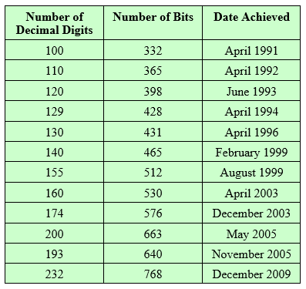
Progress in Factorization
Notes:
Factoring the modulus (N) breaks RSA.
For a large n with large prime factors, factoring is a hard problem,
but not as hard as it used to be. Just as it had done for DES, RSA Laboratories issued
challenges for the RSA cipher with key sizes of 100, 110, 120, and so on, digits. The
latest challenge to be met is the RSA-200 challenge with a key length of 200 decimal
digits, or about 663 bits. Table 21.2 shows the results to date. The level of effort is
measured in MIPS-years: a million-instructions-per-second processor running for
one year, which is about 3 * 10¹³ instructions executed (MIPS-year numbers not
available for last 3 entries).
A striking fact about Table 21.2 concerns the method used. Until the
mid-1990s, factoring attacks were made using an approach known as the quadratic
sieve. The attack on RSA-130 used a newer algorithm, the generalized number field
sieve (GNFS), and was able to factor a larger number than RSA-129 at only 20% of
the computing effort.
The threat to larger key sizes is twofold: the continuing increase in computing
power, and the continuing refinement of factoring algorithms. We have seen
that the move to a different algorithm resulted in a tremendous speedup. We can
expect further refinements in the GNFS, and the use of an even better algorithm is
also a possibility. In fact, a related algorithm, the special number field sieve (SNFS),
can factor numbers with a specialized form considerably faster than the generalized
number field sieve. It is reasonable to expect a breakthrough that would enable
a general factoring performance in about the same time as SNFS, or even better.
Thus, we need to be careful in choosing a key size for RSA. For the near future, a
modulus size in the range of 1024 to 2048 bits seems secure.
In addition to specifying the size of n , a number of other constraints have been
suggested by researchers. To avoid values of n that may be factored more easily, the
algorithm’s inventors suggest the following constraints on p and q :
1. p and q should differ in length by only a few digits. Thus, for a 1024-bit key
(309 decimal digits), both p and q should be on the order of magnitude of
10 ⁷⁵ to 10 ¹⁰⁰ .
2. Both (p - 1) and (q - 1) should contain a large prime factor.
3. gcd (p - 1, q - 1) should be small.
In addition, it has been demonstrated that if e < n and d < n^{1/4} , then d can be easily
determined [WIEN90].

Slide 23
Timing Attacks
Paul Kocher, a cryptographic consultant, demonstrated that a snooper can determine a private key by keeping track of how long a computer takes to decipher messages
Timing attacks are applicable not just to RSA, but also to other public-key cryptography systems
This attack is alarming for two reasons:
It comes from a completely unexpected direction
It is a ciphertext-only attack
Notes:
If one needed yet another lesson about how difficult it is to assess
the security of a cryptographic algorithm, the appearance of timing attacks provides a
stunning one. Paul Kocher, a cryptographic consultant, demonstrated that a snooper
can determine a private key by keeping track of how long a computer takes to decipher
messages [KOCH96]. Timing attacks are applicable not just to RSA, but also
to other public-key cryptography systems. This attack is alarming for two reasons:
It comes from a completely unexpected direction, and it is a ciphertext-only attack.
A timing attack is somewhat analogous to a burglar guessing the combination
of a safe by observing how long it takes for someone to turn the dial from number to
number. The attack exploits the common use of a modular exponentiation algorithm in
RSA encryption and decryption, but the attack can be adapted to work with any implementation
that does not run in fixed time. In the modular exponentiation algorithm,
exponentiation is accomplished bit by bit, with one modular multiplication performed
at each iteration and an additional modular multiplication performed for each 1 bit.
As Kocher points out in his paper, the attack is simplest to understand in an
extreme case. Suppose the target system uses a modular multiplication function that
is very fast in almost all cases but in a few cases takes much more time than an entire
average modular exponentiation. The attack proceeds bit-by-bit starting with the
leftmost bit, b_{k} .
Therefore, if the observed
time to execute the decryption algorithm is always slow when this particular iteration
is slow with a 1 bit, then this bit is assumed to be 1. If a number of observed execution
times for the entire algorithm are fast, then this bit is assumed to be 0.
In practice, modular exponentiation implementations do not have such extreme
timing variations, in which the execution time of a single iteration can exceed the
mean execution time of the entire algorithm. Nevertheless, there is enough variation
to make this attack practical. For details, see [KOCH96].

Slide 24
Timing Attack Countermeasures
Constant
Exponentiation Time
Ensure that all exponentiations take the same amount of time before returning a result
This is a simple fix but does degrade performance
Random Delay
Better performance could be achieved by adding a random delay to the exponentiation algorithm to confuse the timing attack
If defenders do not add enough noise, attackers could still succeed by collecting additional measurements to compensate for the random delays
Blinding
Multiply the ciphertext by a random number before performing exponentiation
This process prevents the attacker from knowing what ciphertext bits are being processed inside the computer and therefore prevents the bit-by-bit analysis essential to the timing attack
Notes:
• Constant Exponentiation Time: Ensure that all exponentiations take the same
amount of time before returning a result. This is a simple fix but does degrade
performance.
• Random Delay: Better performance could be achieved by adding a random delay
to the exponentiation algorithm to confuse the timing attack. Kocher points out
that if defenders do not add enough noise, attackers could still succeed by collecting
additional measurements to compensate for the random delays.
• Blinding: Multiply the ciphertext by a random number before performing
exponentiation. This process prevents the attacker from knowing what ciphertext
bits are being processed inside the computer and therefore prevents the
bit-by-bit analysis essential to the timing attack.

Slide 25
Diffie-Hellman Key Exchange
First published public-key algorithm
By Diffie and Hellman in 1976 along with the exposition of public key concepts
Williamson (UK CESG) secretly proposed the concept in 1970
Used in several commercial products
Practical method to exchange a secret key securely that can then be used for subsequent encryption of messages
Security relies on difficulty of computing discrete algorithms
Notes:
The first published public-key algorithm appeared in the seminal paper by Diffie
and Hellman that defined public-key cryptography [DIFF76] and is generally
referred to as Diffie-Hellman key exchange. A number of commercial products
employ this key exchange technique.
The purpose of the algorithm is to enable two users to exchange a secret key
securely that can then be used for subsequent encryption of messages. The algorithm
itself is limited to the exchange of the keys.
The Diffie-Hellman algorithm depends for its effectiveness on the difficulty of
computing discrete logarithms.

Slide 26
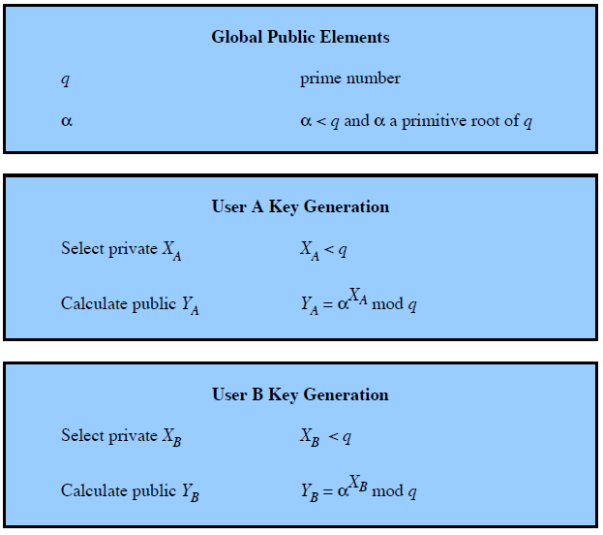
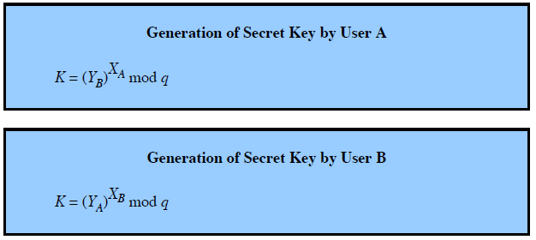
Diffie-Hellman Algorithm
Notes:
The Diffie-Hellman key exchange algorithm is summarized in Figure 21.9. For this scheme, there are two publicly known numbers: a prime number q and an integer α that is a primitive root of q. Suppose the users A and B wish to exchange a key. User A selects a random integer X_{A} < q and computes . Similarly, user B independently selects a random integer X_{B} < q and computes . Each side keeps the X value private and makes the Y value available publicly to the other side. Users A and B compute the key as shown. These two calculations produce identical results, as shown in the text. The result is that the two sides have exchanged a secret value.
Furthermore, because X_{A} and X_{B} are private, an adversary only has the following ingredients to work with: q, α, Y_{A}, and Y_{B}. Thus, the adversary is forced to take a discrete logarithm to determine the key. For example, to determine the private key of user B, an adversary must compute: X_{B} = dlog_{α,q}(Y_{B}). The adversary can then calculate the key K in the same manner as user B calculates it.
The security of the Diffie-Hellman key exchange lies in the fact that, while it is relatively easy to calculate exponentials modulo a prime, it is very difficult to calculate discrete logarithms. For large primes, the latter task is considered infeasible.

Slide 27
Diffie-Hellman Example
Have
Prime number q = 353
Primitive root α = 3
A and B each compute their public keys
A computes Y_{A} = 3⁹⁷ mod 353 = 40
B computes Y_{B} = 3²³³ mod 353 = 248
Then exchange and compute secret key:
For A: K = (Y_{B})^{XA} mod 353 = 248⁹⁷ mod 353 = 160
For B: K = (Y_{A})^{XB} mod 353 = 40²³³ mod 353 = 160
Attacker must solve:
3ª mod 353 = 40 which is hard
Desired answer is 97, then compute key as B does
Notes:
The security of the Diffie-Hellman key exchange lies in the fact that, while it
is relatively easy to calculate exponentials modulo a prime, it is very difficult to calculate
discrete logarithms. For large primes, the latter task is considered infeasible
Here is an example. Key exchange is based on the use of the prime number q = 353 and a primitive root of 353, in this case α = 3. A and B select secret keys X_{A} = 97 and X_{B} = 233, respectively. Each computes its public key:
A computes Y_{A} = 3⁹⁷ mod 353 = 40.
B computes Y_{B} = 3²³³ mod 353 = 248.
After they exchange public keys, each can compute the common secret key:
A computes K = (Y_{B})^{XA} mod 353 = 248⁹⁷ mod 353 = 160.
B computes K = (Y_{A})^{XB} mod 353 = 40²³³ mod 353 = 160.
We assume an attacker would have available the following information:
q = 353; α = 3; Y_{A} = 40; Y_{B} = 248
In this simple example, it would be possible by brute force to determine the secret key 160. In particular, an attacker E can determine the common key by discovering a solution to the equation 3ª mod 353 = 40 or the equation 3^{b} mod 353 = 248. The brute-force approach is to calculate powers of 3 modulo 353, stopping when the result equals either 40 or 248. The desired answer is reached with the exponent value of 97, which provides 3⁹⁷ mod 353 = 40.
With larger numbers, the problem becomes impractical.

Slide 28
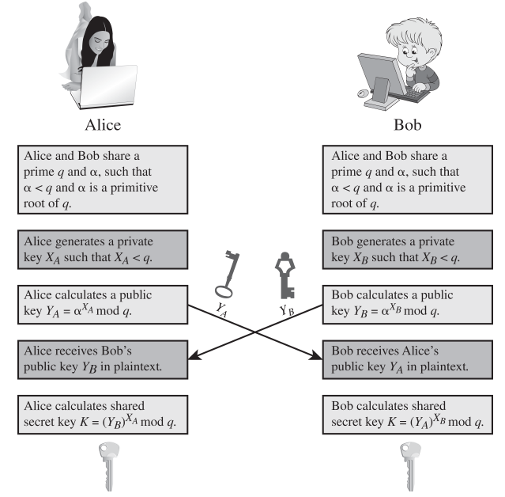
Diffie-Hellman Key Exchange
Notes:
Figure 21.10 shows a simple protocol that makes use of the Diffie-Hellman calculation. Suppose that user A wishes to set up a connection with user B and use a secret key to encrypt messages on that connection. User A can generate a one-time private key X_{A}, calculate Y_{A}, and send that to user B. User B responds by generating a private value X_{B}, calculating Y_{B}, and sending Y_{B} to user A. Both users can now calculate the key. The necessary public values q and α would need to be known ahead of time. Alternatively, user A could pick values for q and α and include those in the first message.
As an example of another use of the Diffie-Hellman algorithm, suppose that a group of users (e.g., all users on a LAN) each generate a long-lasting private value X_{A} and calculate a public value Y_{A}. These public values, together with global public values for q and α, are stored in some central directory. At any time, user B can access user A's public value, calculate a secret key, and use that to send an encrypted message to user A. If the central directory is trusted, then this form of communication provides both confidentiality and a degree of authentication. Because only A and B can determine the key, no other user can read the message (confidentiality). Recipient A knows that only user B could have created a message using this key (authentication). However, the technique does not protect against replay attacks.

Slide 29
Man-in-the-Middle-Attack
Attack is:
Darth generates private keys X_{D1} & X_{D2}, and their public keys Y_{D1} & Y_{D2}
Alice transmits Y_{A} to Bob
Darth intercepts Y_{A} & transmits Y_{D1} to Bob. Darth also calculates K2.
Bob receives Y_{D1} & calculates K1
Bob transmits X_{A} to Alice
Darth intercepts X_{A} & transmits Y_{D2} to Alice. Darth also calculates K1.
Alice receives Y_{D2} & calculates K2
All subsequent communications are compromised
Notes:
The protocol depicted in Figure 21.10 is insecure against a man-in-the-middle attack. Suppose Alice and Bob wish to exchange keys, and Darth is attacks as follows:
1. Darth generates two private keys X_{D1} and X_{D2}, and public keys Y_{D1} & Y_{D2}.
2. Alice transmits Y_{A} to Bob.
3. Darth intercepts Y_{A} and transmits Y_{D1} to Bob. Darth also calculates K2
4. Bob receives Y_{D1} and calculates K1.
5. Bob transmits X_{A} to Alice.
6. Darth intercepts X_{A} and transmits Y_{D2} to Alice. Darth calculates .
7. Alice receives Y_{D2} and calculates .
At this point, Bob and Alice think that they share a secret key, but instead Bob and Darth share secret key K1 and Alice and Darth share secret key K2. All future communication between Bob and Alice is compromised in the following way:
1. Alice sends an encrypted message M: E(K2, M).
2. Darth intercepts the encrypted message and decrypts it, to recover M.
3. Darth sends Bob E(K1, M) or E(K1, M'), where M' is any message. In the first case, Darth simply wants to eavesdrop on the communication without altering it. In the second case, Darth wants to modify the message going to Bob.
The key exchange protocol is vulnerable to such an attack because it does not authenticate the participants. This vulnerability can be overcome with the use of digital signatures and public-key certificates.

Slide 30
Other Public-Key Algorithms
Elliptic-Curve Cryptography (ECC)
Digital Signature
Standard (DSS)
FIPS PUB 186
Makes use of SHA-1 and the Digital Signature Algorithm (DSA)
Originally proposed in 1991, revised in 1993 due to security concerns, and another minor revision in 1996
Cannot be used for encryption or key exchange
Uses an algorithm that is designed to provide only the digital signature function
Equal security for smaller bit size than RSA
Seen in standards such as IEEE P1363
Confidence level in ECC is not yet as high as that in RSA
Based on a mathematical construct known as the elliptic curve
Notes:
The National Institute of Standards and Technology
(NIST) has published this as Federal Information Processing Standard FIPS 186-4
[Digital Signature Standard (DSS), July 2013]. The DSS makes use of the SHA-1 and
presents a new digital signature technique, the Digital Signature Algorithm (DSA).
The DSS was originally proposed in 1991 and revised in 1993 in response to public
feedback concerning the security of the scheme. There were further minor revisions in
1996 and 2013. The DSS uses an algorithm that is designed to provide only the digital
signature function. Unlike RSA, it cannot be used for encryption or key exchange.
The vast majority of the products and standards
that use public-key cryptography for encryption and digital signatures use RSA. The
bit length for secure RSA use has increased over recent years, and this has put a
heavier processing load on applications using RSA. This burden has ramifications,
especially for electronic commerce sites that conduct large numbers of secure transactions.
Recently, a competing system has begun to challenge RSA: elliptic curve
cryptography (ECC). Already, ECC is showing up in standardization efforts, including
the IEEE P1363 Standard for Public-Key Cryptography. A version of ECC used for
digital signature is included as an option in FIPS 186-4.
The principal attraction of ECC compared to RSA is that it appears to offer equal security for a far smaller bit size, thereby reducing processing overhead. On the other hand, although the theory of ECC has been around for some time, it is only recently that products have begun to appear and that there has been sustained cryptanalytic interest in probing for weaknesses. Thus, the confidence level in ECC is not yet as high as that in RSA.
ECC is fundamentally more difficult to explain, and a full mathematical description is beyond the scope of this book. The technique is based on the use of a mathematical construct known as the elliptic curve.

Slide 31
Summary
Secure Hash Functions
HMAC
Authenticated Encryption
The RSA Public-Key Encryption Algorithm
Diffie-Hellman and Other Asymmetric Algorithms
Notes:
Chapter 21 summary.

Slide 32
CECS 378 Section 04 Lab has begun, if you have a question please unmute yourself and use the audio within Zoom

